Slide 1
Section 9.4
Area of a Triangle
Copyright © 2012 Pearson Education, Inc. Publishing as Prentice Hall.

Slide 2

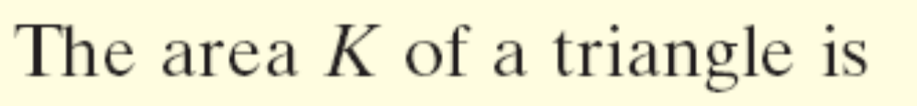
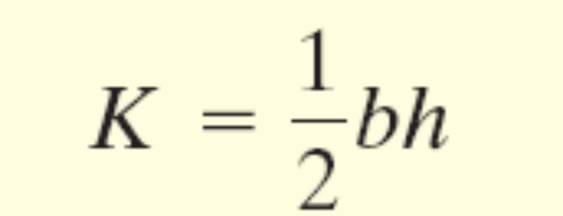
Copyright © 2012 Pearson Education, Inc. Publishing as Prentice Hall.

Slide 3
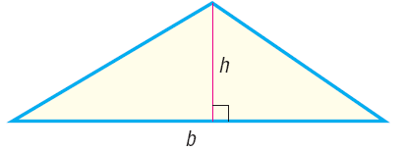
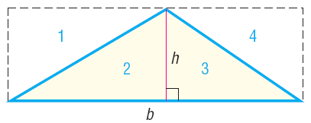
Copyright © 2012 Pearson Education, Inc. Publishing as Prentice Hall.

Slide 4
Copyright © 2012 Pearson Education, Inc. Publishing as Prentice Hall.

Slide 5
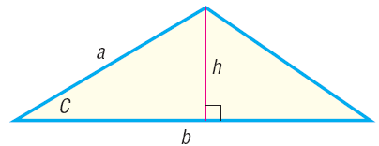
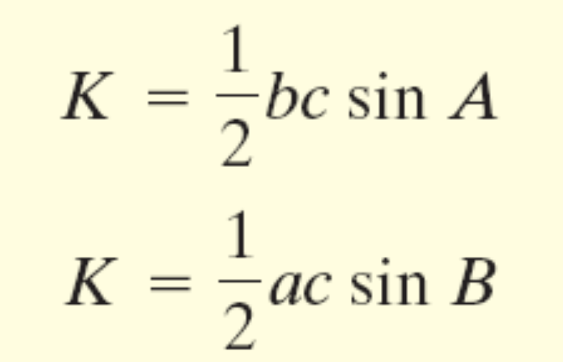
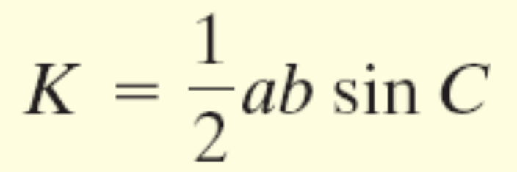
Copyright © 2012 Pearson Education, Inc. Publishing as Prentice Hall.

Slide 6


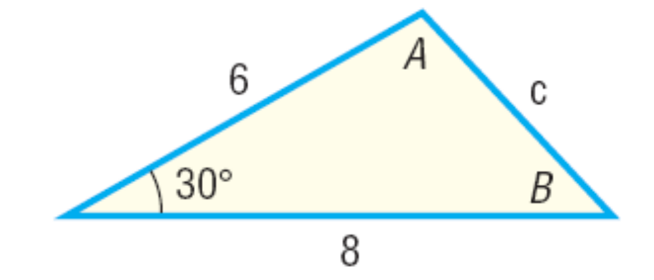
Copyright © 2012 Pearson Education, Inc. Publishing as Prentice Hall.

Slide 7
Copyright © 2012 Pearson Education, Inc. Publishing as Prentice Hall.

Slide 8
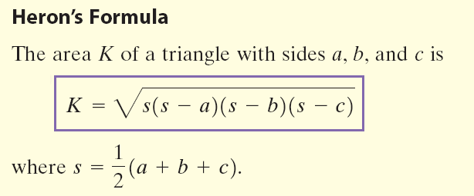
Copyright © 2012 Pearson Education, Inc. Publishing as Prentice Hall.

Slide 9
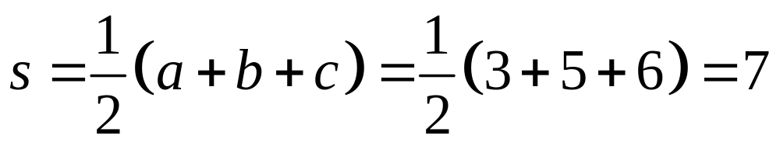
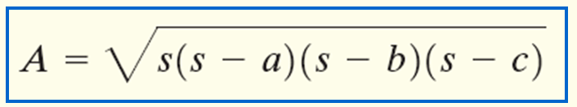
Find the area of a triangle whose sides are 3, 5, and 6.
Copyright © 2012 Pearson Education, Inc. Publishing as Prentice Hall.

